Slide 1
IMU（惯性测量单元）

Slide 2
What is Attitude（角度？姿态？）
Orientation of a coordinate system (u,v,w) with respect to some reference system (x,y,z)
坐标系中相对于某个参考系的方向

Slide 3
Why we need Attitude information 为什么我们需要角度（姿态）信息？
Obtaining an accurate vehicle attitude is essential for airplane navigation and control applications. The effectiveness of navigation and control is determined by the degree of precision of the navigation and control systems, including inertial measurement units(IMU).
获取准确的飞行姿态是飞行器导航和控制的基础，导航和控制的有效性取决于导航和控制系统的准确程度，这其中就包括IMU惯性测量单元

Slide 4
How to get Attitude
The attitude of the aero-vehicle can be determined by integrating the angular rates (pitch, roll, and yaw rates) of the vehicle. Nevertheless, accuracy requirements usually cannot be satisfied by using the inexpensive MEMS sensors. Therefore, some forms of Kalman filtering or complementary fusion algorithms are normally employed to provide more accurate and reliable attitude angles in the MEMS attitude determination systems.
飞行器的角度（姿态）可以通过对角速度（俯仰角速率、滚转角速率、偏航角速率）的积分来获得。但是偏移的传感器并不能达到精确度的要求，因此一些如卡尔曼滤波和互补融合的算法经常被用来得到更加精确可靠的姿态角。

Slide 5
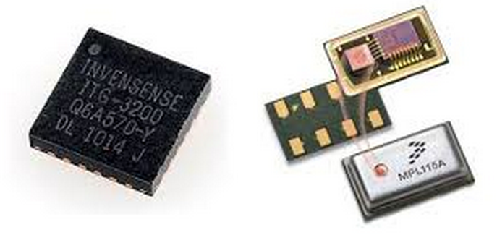
Attitude sensors 角度传感器
Accelerometers 加速度感应器
Gyroscopes 陀螺仪
gimbaled gyroscopes, laser gyroscopes, and fiber optic gyroscopes and accelerometers—provide high-precision information for navigational calculations .they are, however, expensive and bulky. With the maturation and advancement of semiconductor manufacturing technology, MEMS sensors are increasingly used in flight attitude calculations
万向陀螺仪、镭射陀螺仪、光纤陀螺仪和加速计可以为导航计算提供更精确的信息。但是他们又贵又笨重，随着半导体工艺的发展和成熟，MEMS传感器逐渐被广泛地应用到飞行角度计算中。

Slide 6
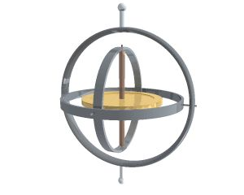
Gyroscopes
A gyroscope has the capability of measuring the rate of rotation around a particular axis. For instance if a gyroscope is used to gauge the rate of rotation around the roll axis of an aircraft, it will come up with a non zero roll value, so long as the aircraft continues to roll, but shows zero if the roll stops
陀螺仪可以测量物体围绕某条轴的旋转速度，比如用一个陀螺仪测量飞行器围绕辊轴的旋转速度，只要飞行器在转，它就会显示一个非零值，直到它停下来。

Slide 7
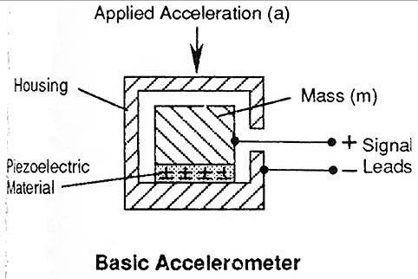
Accelerometer
A 3 axis accelerometer has the ability to gauge the orientation of a stationary platform relative to the earth’s surface. If the platform happens to be in free fall, the acceleration will be shown to be zero. If it is only accelerating in a particular direction the acceleration will be indistinguishable from the acceleration being provided by the earth’s gravitational pull. So an accelerometer alone cannot be used to have an aircraft maintain a particular orientation.
一个三轴加速度感应器可以测量一个静止平台相对于地平面的角度，如果平台恰好处于自由下落状态，加速度会显示为0.如果它只朝某个特定方向加速，那么这个加速度就会和地心引力造成的加速度有所区别（大概意思是加速度计可以感应所有非地心引力造成的加速度），所以只有一个加速度计并不能使飞行器保持在特定方向。

Slide 8
Difference Between Gyroscope and Accelerometer 陀螺仪和加速度计的区别
Accelerometer measures linear motion and gravity. 加速度计测量直线运动和重力
Accelerometer detects and measures electrical current that derives from muscular action.
加速度计可以感应和测量由于肌肉运动（对加速度计作用）产生的电流
The magnitude of the signal in the case of accelerometer is biased by gravity. This is not the case with gyroscope.
加速度计的信号幅值受重力影响（基于重力），而陀螺仪并不。
Information pertains to bandwidth and frequency available to the extent of zero frequency in the case of gyroscope. That may not be the case with an accelerometer.
对于陀螺仪来说，信息受到零频率范围内可用代带宽和可用频率的约束，而加速计不。（不知道对不对）

Slide 9
Difference Between Gyroscope and Accelerometer 陀螺仪和加速度计的区别
A onetime integration is sufficient to achieve angular displacement in the case of gyroscope, whereas a difficult two time integration is required in the case of accelerometer.
陀螺仪积分一次就可以得到角偏移，而加速度计要积分两次。
There is high signal to noise ratio in the case of gyroscope, while in accelerators, there is mostly a low signal to noise ratio.
陀螺仪的信噪比很高，而加速度计的信噪比通常比较低。

Slide 10
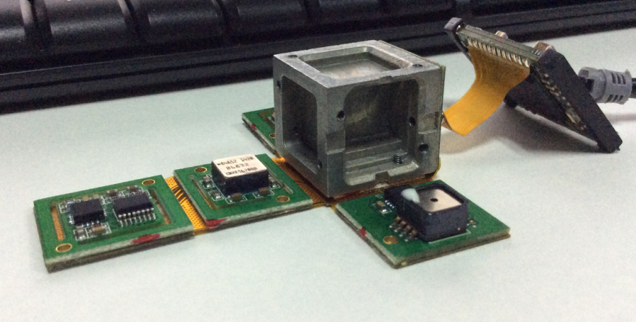
IMU of WKM Flight Controllers
Accelerometer：ADXL326
Gyroscopes： ADXRS620

Slide 11
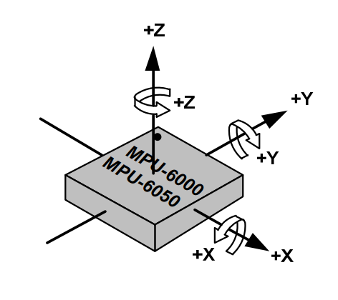
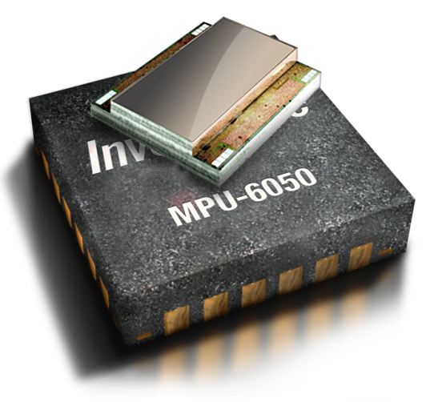
MPU-6050
combine a 3-axis gyroscope and a 3-axis accelerometer on the same silicon die.
Orientation of Axes of Sensitivity
and Polarity of rotation
Gyro Full Scale Range | Gyro Sensitivity | Accel Full Scale Range | Accel Sensitivity | Digital Output
±250 | 131 | ±2 | 16384 | I²C
±500 | 65.5 | ±4 | 8192
±1000 | 32.8 | ±8 | 4096
±2000 | 16.4 | ±16 | 2048

